Slide 1


Computer Organization & Architecture
Chapter 14
Instruction Level Parallelism
and Superscalar Processors

Slide 2
What is Superscalar?
Superscalar Processor:
  Such a CPU that can execute multiple instruction pipelines at the same time
  Fetch multiple instructions at a time
  Instruction-level parallelism
E.g. : Common instructions (arithmetic, load/store, conditional branch) can be initiated and executed independently
Equally applicable to RISC & CISC

Slide 3
14.1 Overview
Why Superscalar?
  Most operations are on scalar quantities (see RISC notes)
  Improve these operations to get an overall improvement

Slide 4
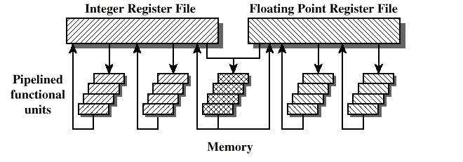
General Superscalar Organization

Slide 5
Features of Superscalar
  The essence of superscalar is the ability to execute instructions independently in different pipelines
    Multiple functional units, each is implemented as a pipeline
  Allow instruction to be executed in an order different from the program order

Slide 6
What is superpipeline?
  Many pipeline stages need less than half a clock cycle
  Double internal clock speed gets two tasks per external clock cycle
    It means that two results are generated in a slot
Superscalar allows parallel fetch and execute multiple instructions

Slide 7
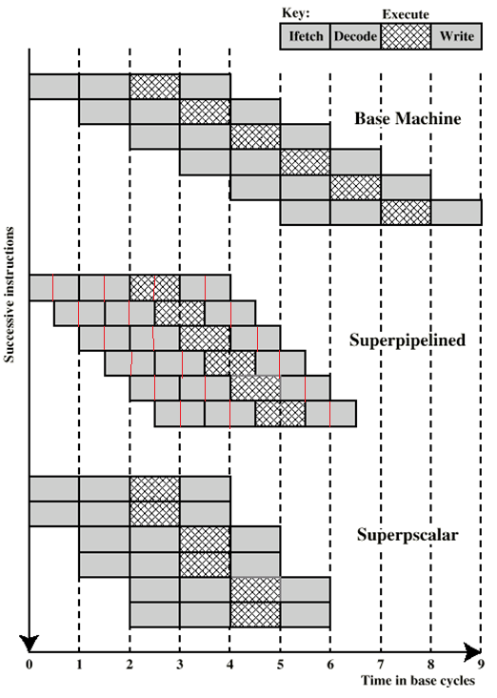
Superscalar v
Superpipeline

Slide 8
Specifications for Fig14.2
  Parallelism degree is 2
  Of course, higher degree superscalar and superpipeline are possible
  Superpineline ‘performance is basically equal to superscalar
    Both have two instructions executing at the same time
    Two results/ 1 clock cycle
  But, at the start of the program and each branch, the superpipeline falls behind the superscalar

Slide 9
Limitations
  Instruction level parallelism
  Compiler based optimisation
  Hardware techniques
  Limited by
    True data dependency
    Procedural dependency
    Resource conflicts
    Output dependency
    Antidependency

Slide 10
True Data Dependency
  ADD r1, r2 (r1 := r1+r2;)
  MOVE r3,r1 (r3 := r1;)
  Can fetch and decode second instruction in parallel with first
  Can NOT execute second instruction until first is finished
  Also called write-read dependency or flow dependency

Slide 11
Procedural Dependency
  Can not execute instructions after a branch until the branch is executed
  Also, if instruction length is not fixed, then another sort of procedural dependency arises
    Because the length of any particular instruction is not known
    It must be decoded to find out how many fetches are need
  This prevents simultaneous fetches in a superscalar pipeline

Slide 12
Resource Conflict
  Two or more instructions requiring access to the same resource at the same time
  Resources includes
    Memory
    Cache
    Bus
    Registers
    Functional units, etc
  Can duplicate resources
    e.g. have two arithmetic units

Slide 13
Output dependency
  I1: Add R6, R3 (R6 := R6 + R3;)
  …
  I4: Mov R6, R7 (R6 := R7;)
  Can fetch and decode second instruction in parallel with first
  Can NOT execute the I4 instruction until I1 is finished

Slide 14
Antidependency
  I1: ADD R3, R4 (R3 := R3 + R4;)
  I2: MOV R4, R5 (R4 := R5;)
  Can fetch and decode second instruction in parallel with first
  Can NOT execute second instruction until first is finished

Slide 15
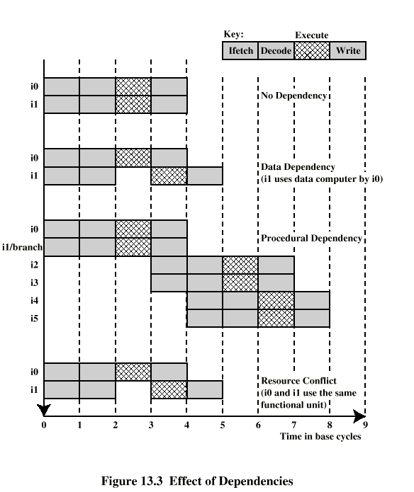
Effect of
Dependencies

Slide 16
14.2 Design Issues
Instruction level parallelism
  Instructions in a sequence are independent
  Execution can be overlapped
  Governed by data and procedural dependency
Machine level Parallelism
  Ability to take advantage of instruction level parallelism
  Governed by number of parallel pipelines and instructions dependency

Slide 17
Instruction Issue Policy
  Instruction issue --- Initiate instruction to be executed in CPU
  Instruction issue policy --- the protocol used to issue instructions
  Three types of important ordering
    Order in which instructions are fetched
    Order in which instructions are executed
    Order in which instructions change registers and memory

Slide 18
Superscalar instruction issue policies:
  In-order issue with in-order completion
  In-order issue with out-of-order completion
  Out-of-order issue with out-of-order completion

Slide 19
In-Order Issue In-Order Completion
  The simplest instruction-issue policy
  Issue instructions in the order they occur
    In-order issue, in-order execution, in-order write
    See Fig14.4a
  May fetch >1 instruction
  Not very efficient
  Instructions must stall in order to keep sequence of instructions

Slide 20
指令 | 执行时间（cycle） | 执行时使用部件 | 相关性
I1 | 2 | a | 无
I2 | 1 | b | I2 I5 I6 资源冲突
I3 | 1 | c | I3 I4资源冲突
I4 | 1 | c | I3 I4资源冲突，与I5有相关性
I5 | 1 | b | I5依赖于I4的执行结果，I2 I5 I6 资源冲突
I6 | 1 | b | I2 I5 I6 资源冲突

Slide 21
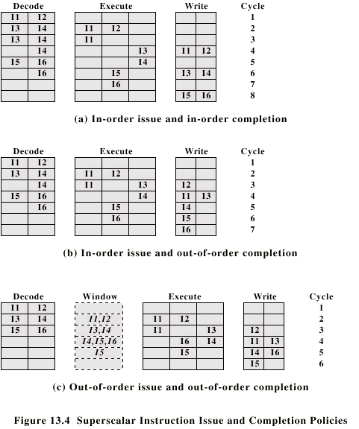
In-Order Issue In-Order Completion
a b c

Slide 22
In-Order Issue Out-of-Order Completion
  Execution and output as soon as possible
  Instructions issuing is stalled by a resource conflicts, a data dependency, or a procedural dependency
  Require more complex instruction-issue logic and interrupt control

Slide 23
In-Order Issue Out-of-Order Completion
a b c

Slide 24
Out-of-Order Issue
Out-of-Order Completion
  with in-order issue, if a dependence is met, pipeline will be pause until the conflict solved
  Decouple decode pipeline from execution pipeline, to do this, a buffer is need, called instruction window
  Can continue to fetch and decode until this window is full , viz., this pipeline is full

Slide 25
  When a functional unit becomes available an instruction can be executed
    Any instruction may be issued, provided that functional unit is available and no conflicts block this instruction
    Original sequence is broken, but result must be correct
  Since instructions have been decoded, processor can look ahead

Slide 26
Out-of-Order Issue Out-of-Order Completion
a b c

Slide 27
Comments
  Instruction window is not an additional pipeline stage
  An instruction cannot be issued if it results in a dependency
  In fact, it is a mode that makes use of delay time, independent instructions are executed ahead of the dependency instruction
  Reducing the stalling times
  Antidependency (read-write dependency) may arise

Slide 28
Antidependency
  Read-write dependency (can not write before reading over)
    R3:=R3 + R5; (I1)
    R4:=R3 + 1; (I2)
    R3:=R5 + 1; (I3)
    R7:=R3 + R4; (I4)
    I2 depends on result of I1 - data dependency
    I3 can not complete before I2 starts as I2 needs a value in R3 and I3 changes R3
    Meantime, I3 can not complete before I1 starts, If I3 completes before I1, the result from I1 will be wrong - output (read-write) dependency

Slide 29
Register Renaming
  Output and antidependencies occur because register contents may not reflect the correct ordering from the program
  A method of solving antidependency is:
    stalling the pipeline
  Another method is register renaming
    In fact, it is just duplication of resources
    Using a different register

Slide 30
Register Renaming example
    R3b:=R3a + R5a (I1)
    R4a:=R3b + 1 (I2)
    R3c:=R5a + 1 (I3)
    R7b:=R3c + R4a (I4)
  Without subscript refers as to logical register in instruction
    given in program or by compiler)
  With subscript is hardware register allocated
    Just for pipelining
  With renaming, I3 can be issued immediately

Slide 31
An Example
I1: LOAD R1, A
I2: FADD R2, R1
I3: FMUL R3, R4
I4: FADD R4, R5
I5: DEC R6
I6: FMUL R6, R7
  I1~I2: Write-read dependency
  I3~I4: read-write dependency
  I5~I6: write-read dependency, output dependency
  I2~I4: functional unit dependency
  I3~I6: functional unit dependency

Slide 32
Machine Parallelism
  3 hardware techniques used in a superscalar processor to improve performance
    Duplication of Resources
    Out of order issue
    Renaming
  Some experts studied these techniques
    base machine can only issue instructions out of order
    2nd configuration duplicates the load/store
    3rd configuration duplicates the ALU
    4th configuration duplicates the ALU and load/store

Slide 33
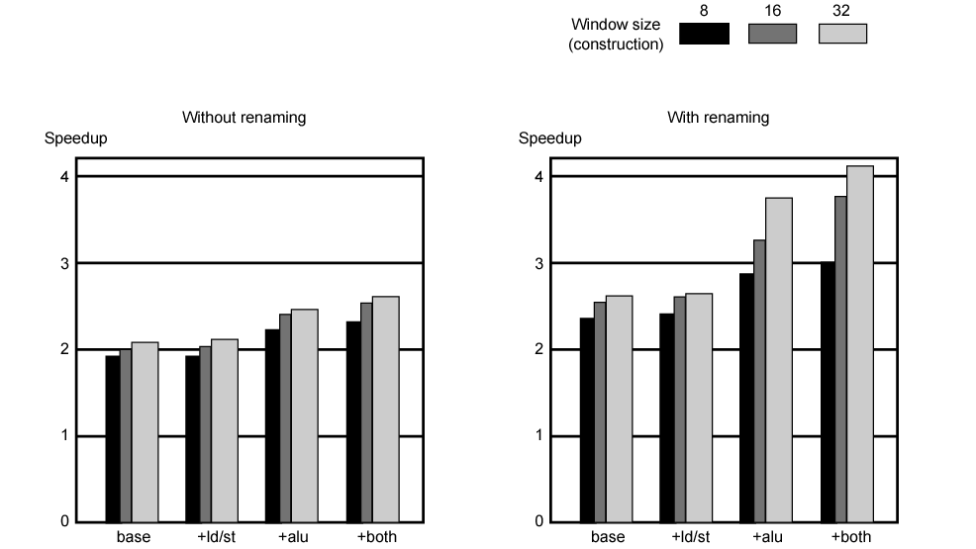
Speedups of Machine Organizations
Without Procedural Dependencies

Slide 34
Branch Prediction
  80486 fetches both next sequential instruction after branch and branch target instruction
  Gives two cycle delay if branch taken
  Predictions:
    Static branch prediction
      Branch always occurs
      Always does not occurs
      Both, such as 80486
    Dynamic branch prediction
      Branch history analysis

Slide 35
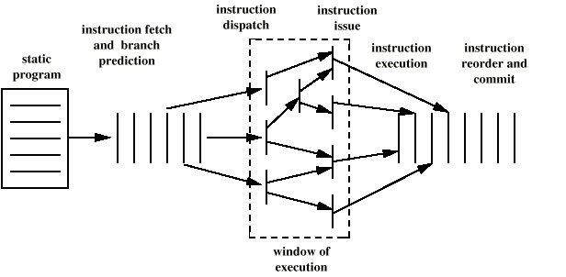
Superscalar Execution

Slide 36
Superscalar Implementation
  Simultaneously fetch multiple instructions
  Logic to determine true dependencies involving register values
  Mechanisms to communicate these values
  Mechanisms to initiate multiple instructions in parallel
  Resources for parallel execution of multiple instructions
  Mechanisms for committing process state in correct order

Slide 37
Key Points
What is superscalar? Which elements may limit its performance? How to improve the performance?
Instruction-issue Policy
Register Renaming
Superscalar organization of PII & P4

Slide 38
Homework
1. 超标量中指令并行性主要受限于哪几个方面？
2.下列指令序列，各存在什么相关性，在超标量中是如何解决这些相关性的？
I1: LOAD R1, X
I2: ADD R2, R1
I3: MUL R2, R4
I4: MOVE R4, R5

